Slide 1


Prison Population: Long Term and Elderly Population
Friday, February 4, 2022

Slide 2
Introduction
June 30th 2021 Prison Population Characteristics
Focus pool - “long-termers”: those who have been incarcerated 20+ years
How did this population accrue?
Life Sentences and Truth-in-Sentencing
Elderly population
Intersection of elderly population and long-termers

Slide 3
June 30, 2021 Prison Population: 27,413
3,235 (12%) of the prison population on June 30, 2021 have already served 20 years.
Additionally, about 5,200 currently incarcerated are projected to serve over 20 years but have not done so yet.

Slide 4
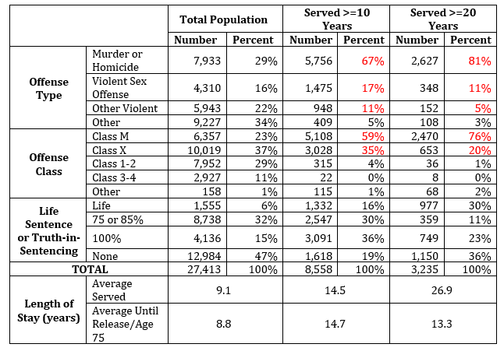
Offense and Prison Characteristics

Slide 5
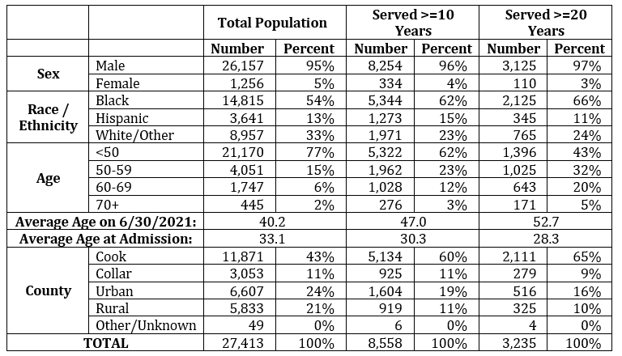
Demographics June 30, 2021
Note: Total population includes technical violators.

Slide 6
Long-Term Prison Population Growth by Sentence Type

Slide 7
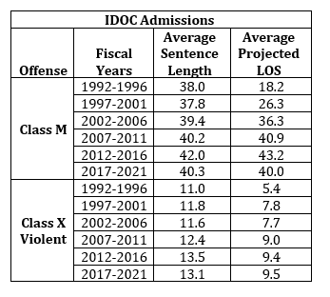
The Impact of TIS on Length of Stay
Average Projected LOS for admissions above may also include additional lengths of stay from any consecutive sentences.

Slide 8
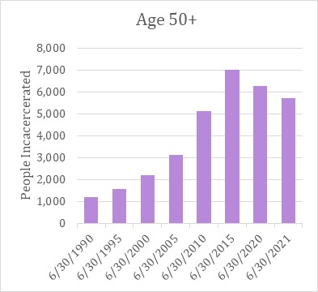
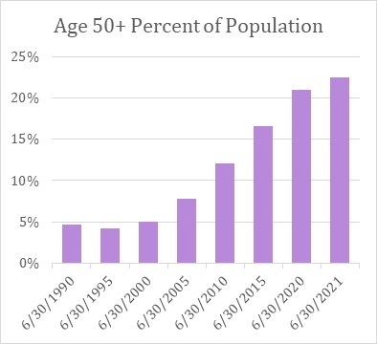
“Elderly” Population

Slide 9
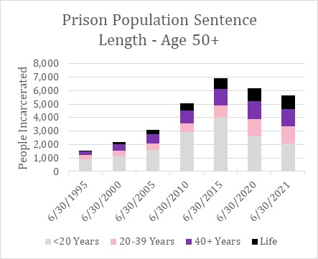
Age 50+ Sentence Distribution

Slide 10
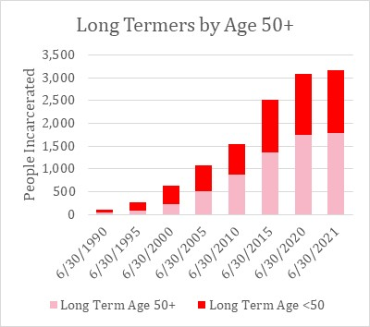
Age 50+ and Long-Termers

